Slide 1

Study on the implementation of the Concessions Directive
(Directive 2014/23/EU)
Stakeholders’ workshop
15 Nov 2021

Slide 2

Agenda
Objectives of the study
Overview of the methodology/ challenges
Main results from the legal analysis
The use of concessions pre and post adoption of the Concessions Directive
Case studies
Overall conclusions

Slide 3
Objectives of the study
Evaluate the functioning of the Concessions Directive
Form an overview and understanding of how the Concessions Directive is currently applied and how much it is being used across the EU in different economic sectors:
Part 1: Mapping of the existing situation in Member States regarding the use of concessions
Part 2: Compilation of a stock of good/bad practices in the Member States and EEA countries

Slide 4
Legal analysis
Research questions
Main findings
transposition practice
use of concessions-related terminology
information on the main changes to the legal frameworks since the adoption of the Directive
case law, and good and bad practices in relation to the transposition and implementation of the legal framework for the awarding of concessions.
In a majority of countries, the Concessions Directive has been transposed through new legislation, via an Act of Parliament, and at the national level.
Most countries use substantively different wording in their definition of concessions
Most countries include a reference to the operational risk element of the definition of concessions in their national transposing measures
Most EU and EEA countries use the term “concession” in national measures beyond transposing legislation referring to other legal concepts.
In a small number of countries national legislation not transposing the Directive refers to a term other than a “concession” in order to refer to a concession within the meaning of the Directive
Multiple countries have diverging definitions of the term PPP at national level and/or unclarity as to how legislation on this topic refers to the definition of and rules on concessions
Case law potentially reflects legal uncertainty on the definition of concessions, concession value calculation and concessionaire obligations and remuneration

Slide 5
Data analysis methodology - identification of concessions
The data analysis is based on concession contracts information published from 2012 to 2019
Concession contracts have been identified in two ways:
  through the use of concession-specific standard forms in TED (Tenders Electronic Daily, the European public procurement journal)
  via a keyword-based methodology which searched for concessions published outside concession-specific standard forms
Concession-specific standard forms
 |  | Pre-Directive | Post-Directive
CONTRACT NOTICES | Works concessions | Yes | Yes
 | Services concessions | No | Yes
CONTRACT AAWARDS | Works concessions | No | Yes
 | Services concessions | No | Yes
Concessions
Concessions are contracts for pecuniary interest whereby one or more contracting authorities or contracting entities entrusts works or the provision and management of services to one or more companies.
The reward for the works or services consists in the right to exploit them […, which ] implies the transfer to the concessionaire of an operating risk of economic nature […].

Slide 6
Data analysis - main trends
all concessions
Very significant increase in the post-Directive yearly number of concessions
Directive
service concessions
Increase in services concessions is well above the pre-Directive trend
works concessions
Decrease in works concessions is in line with, or somewhat less than, pre-Directive trend

Slide 7
Data analysis - contract values and type of procedures
Total yearly value of concessions increased sharply post-Directive, by about 6-fold, on average
  The yearly number of concessions roughly doubled in the post-Directive years
  Average value of contracts, therefore, increased markedly
Both value and number of “negotiated procedures with a call for competition” have increased substantially
The use of “open procedures” remained stable in number and in value
Two types of procedure gained particular significance in value terms: “awards without prior publication of a contract notice” and procedures “negotiated without a call for competition”
Value in € billion
Number of contracts
Directive
Directive

Slide 8
Data analysis – country-level use and evolution
The use of concessions is highly concentrated: the top four countries with the largest number of concessions (France, Italy, Germany, and Spain) represent 84% of all post-Directive concession contracts.
Growth in use also quite asymmetric:
over ten-fold increases in some countries
decreases in others

Slide 9
Data analysis – country-level use and evolution
Use of works concessions
Countries’ share of the growth in post-Directive use of concessions
France, Italy and Germany are responsible for about ¾ of the increase in the yearly average number of concessions, post-Directive
France alone has 40% of all post-Directive concessions and represents 50% of the post-Directive growth.
Works concessions are highly concentrated in a small number of countries;
post-Directive decreases are observed in the generality of these

Slide 10



Data analysis – sectoral use
The top three sectors with the largest number of concessions in the post-Directive period represent 37% of all post-Directive concessions:
‘Hotel, restaurant and retail trade services’,
‘Construction work’, and
‘Recreational, cultural and sporting services’
‘Construction work’ is the only major sector that registered a decrease in the average number of concessions per year in the post-Directive period
The sectoral use of concession contracts and growth thereof is extremely asymmetric across sectors and countries

Slide 11
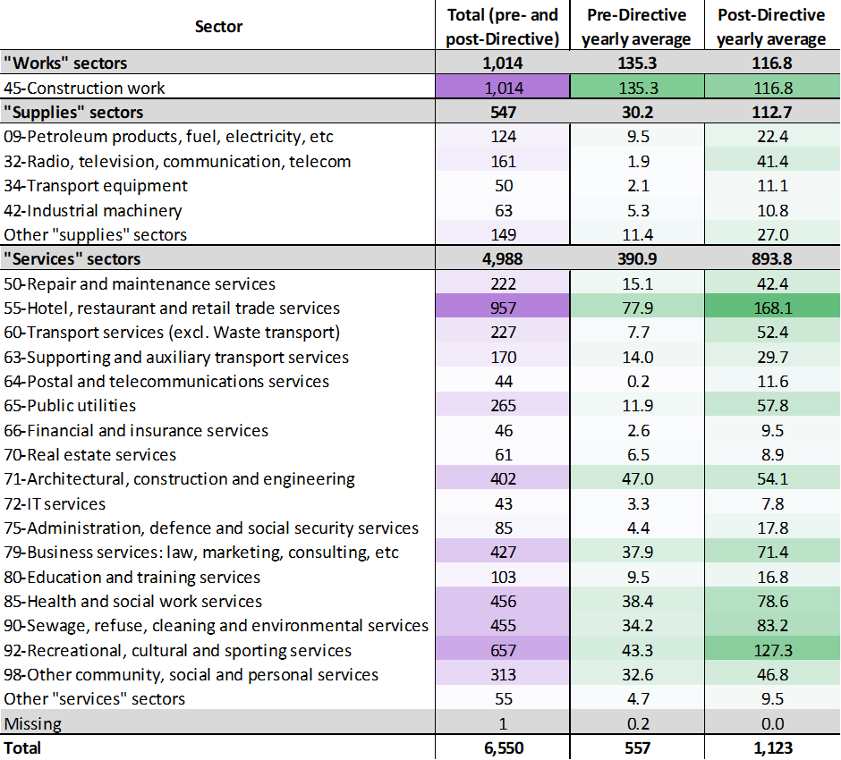
Data analysis – sectoral use
A small number of sectors make up the vast majority of concessions
- ‘Hotel, restaurant and retail trade services’
- ‘Construction work’
- ‘Recreational, cultural and sporting services’
Together, they represent 37% of all post-Directive concessions.
‘Construction work’ is the only major sector that registered a decrease in the average number of concessions per year in the post-Directive period
Sharpest increases were observed in
-Hotel, restaurant and retail trade services’
- ‘Recreational, cultural and sporting services’
The use of concession contracts and growth thereof is fairly asymmetric across sectors and countries

Slide 12
Data analysis – competition and transparency
Average number of bidders
Only 6 countries registered an increase in the average number of tenderers: Czechia, Finland, Romania, Slovakia, Spain and Norway
(note: information is somewhat sparse)
SME participation
In five countries SMEs were among the winning bidders on over 50% of tenders: Malta, Finland, Estonia, Sweden, and Slovenia
(note: samples restricted to countries where SME participation covered 10 contracts or more)

Slide 13
Case studies - overview
Objective: illustrate the use of the Concessions Directive and associated instruments, supporting procedures for awarding of concession contracts and specific examples of good and bad practices
6 case studies illustrate ways in which national authorities have sought to
support the objectives of the Concessions Directive and
strengthen the institutional and knowledge base required to achieve them.
Guidance accompanying the national implementations
The role of specialised entities
The practice of ‘market sounding’
Online publication initiatives
Risk identification, assessment and allocation
Rules and guidance on the use of contract modifications
2 case studies draw on recent jurisprudence to reflect the challenges associated with the interpretation of the Directive
Case law examples: the definition of concession contracts
Case law examples: calculation of the value of concession contracts
2 cases look at the use of concession contracts in two particular sectors
The use of concession contracts in road concessions
The use of concession contracts in the sector of offshore wind

Slide 14
Case studies – conclusions – support measures
Measures supporting the objectives of the Directive
Some limitations
National authorities providing very detailed guidelines covering multiple aspects of procurement of concession contracts, in an array of formats, including concrete examples
Widespread establishment of specialised entities with responsibilities over concessions regulation and policy guidance and over concessions capacity building
Guidance on the performance of market analyses (‘market sounding’), to assess private sector’s potential interest and capacity, prior to initiation of the awarding procedure?
A wealth of transparency and publication initiatives across most countries, with national online platforms where concession notices and documentation can be viewed consistently offered
Explicit requirements as well as methodology guidance on risk identification, assessment and allocation
Additional scrutiny on the use of contract modifications
The Specialised entities, for the most part, have quite narrow mandates. Their responsibilities generally exclude provision of technical support in implementation of concession projects and oversight responsibility over the implementation of these contracts
The practice market sounding is rarely ‘recommended’ nor, for the most part, is any detailed guidance provided on how to perform it.
On the aspect of risk, only very few countries have concrete requirements and methodological guidance such as on developing a risk matrix. Even fewer countries have any requirements or guidance on risk management/prevention/mitigation measures.
On the use of modifications, detailed guidance and practical examples ought to be more widespread.

Slide 15
Case studies – conclusions – case law
The two case studies that reviewed case law provided an interesting insight into some of the challenges faced by national authorities.
The case law on the definition of what constitutes a concession seems far from settled.
Different answers are found to questions such as
- whether the definition of a contract as a concession is independent from the object of the contract;
- whether, instead, the subject of a service concession must be the provision of service in the name of the public entity;
- whether contracts that involve fixed payments to the public partner can be considered to leave sufficient risk to the private partner to be considered a concession; and
- whether the provision of a service, to be considered a concession must be subject to detailed service obligations imposed by the public authority.
Instances of errors made by contracting authorities, linked to
- failure to adopt appropriate and transparent value calculation methods.

Slide 16
Case studies – conclusions – sectoral cases
Road sector case study –
early contracts
Road sector case study – recent example from Norway
many years before the entry into force of the Concessions Directive
illustrates failings of implementation that used to be commonplace at that time.
  inadequate sharing of risk between the public and private partners,
  lack of technical knowledge on the part of the contracting authorities
  resulting in poorly specified technical requirements,
  huge variation in technical aspects of the tenders submitted,
  inadequate contracting arrangements,
  substantial delays, and
  frequent renegotiations which invariably substantially increased the costs of the project to the contracting authority.
The contracting authority built significant technical capability and carefully planned the procurement over many years.
Objectives, technical requirement, and contracting arrangements were fully transparent.
Contractors did take on any of the revenue risk associated with traffic risk.
Instead, the authority pays the contractor an availability payment with is independent from realised traffic.
Recognising that contractors should be allocated only the risks that they can manage such as construction risk, and management and operation risk.
The principle that risks which the contractor cannot manage may be more effectively addressed outside the concession contract, was successfully adopted in the offshore wind case stud.

Slide 17
Overall conclusions
At national level, we found multiple examples of good practices in terms of supporting measures
  but some case law suggests remaining uncertainty about application of the Directive’s concepts
The data shows a clear association between the implementation of the Directive and greater use of concessions
The use of concessions as well as its evolution in the post-Directive period are strikingly asymmetric across countries and sectors
  A small number of countries concentrate a large fraction of all concessions and of post-Directive growth in use of concessions
  Works concessions are particularly concentrated in a few countries
  Service concessions are concentrated in a few sectors
The Directive appears to have promoted transparency in relation to very high value concessions, with a 6-fold increase in reported values, on average, in the post-Directive period
  Similarly, recording of SME participation has improved in the post-Directive period

Slide 18
If you have any questions, please get in touch
Paula Ramada pramada@le-europe.eu
Dano Meiske dmeiske@le-europe.eu
James Cannings jcannings@le-europe.eu

