Slide 1
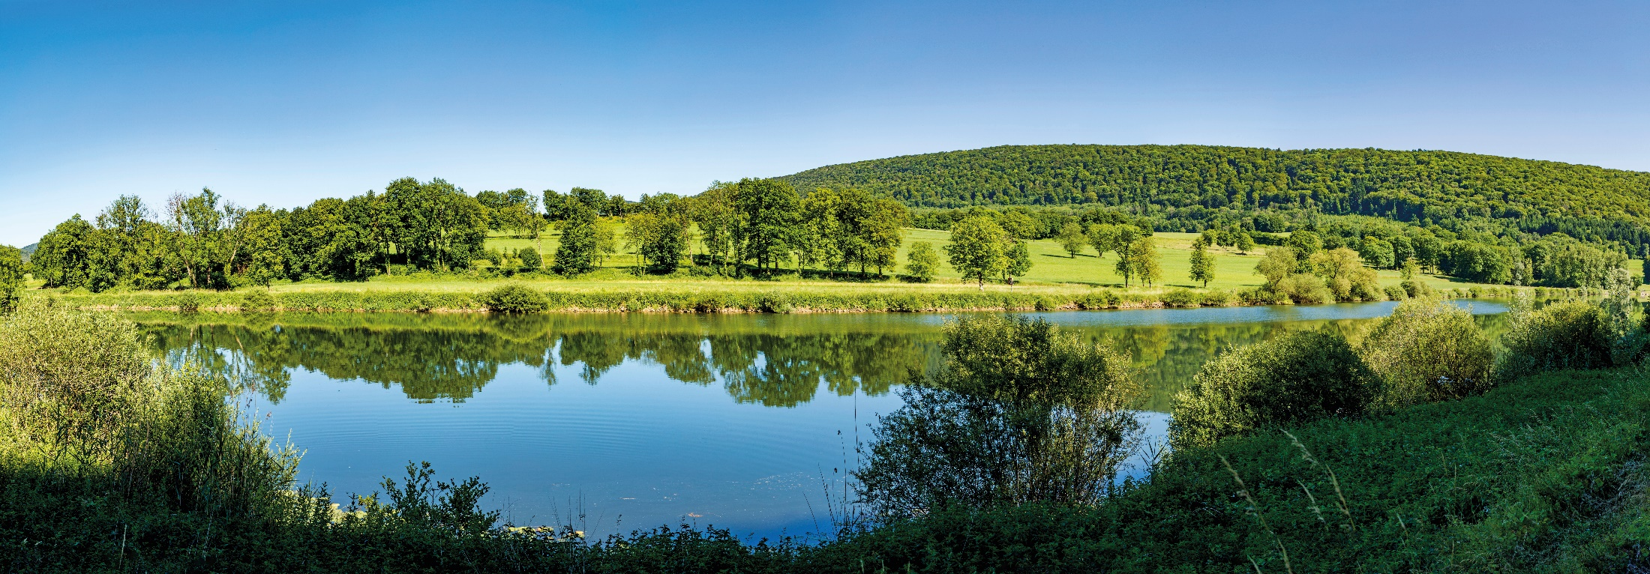
Concessions Directive in water and wastewater sector
state of play in France after 5 years applying
Talk based on EU-DG Grow questions -
November, 15th 2021
Tristan MATHIEU
General delegate of Professional Federation of Water Companies

Slide 2
How the Concessions Directive was transposed in France ?
Why the Concessions Directive was easily transposed in 2016, and easily applied, including the water sector ?
Eased by +20 years experience of a French Law * based on the same principles : competition and transparency.
For France, Concessions Directive was an opportunity to refresh its legal framework
For local authorities and operators, the new bidding procedures are in the continuity of the previous ones, with an additional legal security brought up by the Directive
Including drinking water sector (already covered by the French competition law)
water concessions contracts subject to LIGHT procedure
wastewater concessions contracts subject to :
LIGHT REGIME procedure when < 5.3 million € turnover
ORDINARY procedure when > 5.3 million € turnover
* 1993
Before and since 2016,
100% local authorithies are free to delegate or not the management of their water or sanitation service.
If they delegate, they follow the directive rules : competition and transparency
Since 2016, 100% of French water and wastewater concessions have be€en applying European transposed rules.

Slide 3
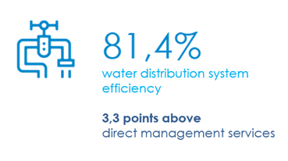
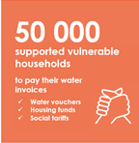
2. What organisational structure contribute to make drinking water and sanitation services more efficient to consumers in France ?
Concessions do contribute
To water quality
To water ressources protection
3,3 points is the equivalent of :
100 millions m³ saved water
total drinking water produced by : Strasbourg Metropole + Nice city + Rennes Metropole
To social innovation
To consumer relationship innovation
94% consumers have the possibility to turn to the Water Mediator
80% disputes solved
1st Social Water Bond
1st social tariff

Slide 4
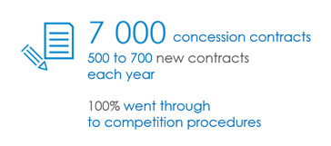
3. Trends in management models and key arguments in decision making
Population desserved through concessions shows stability over the years.
Water companies are partners of local authorities through 7 000 concessions
Contract reversibility is unchanged since the Concessions Directive
Between private operators
Between private and public operator
In public procurement, litigations have not increased since the Concessions Directive
2016 : 5%* 2017 : 2%*
*Source : Enquête 2017 de l’Observatoire ≪ loi Sapin ≫ (OFB, AgroParisTech)
FP2E Transfer charter
Local authorities as free as ever
to change their private operator, or to change from a management model to another

Slide 5
3. Trends in management models and key arguments in decision making
Key arguments in decision making in matters of management model : PERFORMANCE, EFFICIENCY, INNOVATION, HUMAN RESOURCES
100% of contracts signed by private companies include reporting on the national performance indicators
Technical and financial results
Managing the infrastructures
Quality of service …
Data consolidated and transferred to Office Français de la Biodiversité in order to feed a national data base
Delegated company remuneration may be partly based on performance
with indicators (bonus/malus)
An annual delegate report is due to the local authority and the rules between the parties are clearly defined
+ 1 million performance indicators in 10 years, consolidated
in BIPE/FP2E survey

Slide 6
4. Why more Member States should implement the Concessions Directive
in the water sector ?
Concessions Directive imposes transparency principles that should beneficiate to ALL EUROPEAN CONSUMERS of drinking water services
In a context of MAJOR ISSUES for water and wastewater public services
Becoming more resilient to climate change
Giving access to all to drinkable water and wastewater services
Increasing even more water quality, tackling micropollutants, pesticides …
Protecting environment and biodiversity through improved treated wastewater discharge
Contributing to Green Deal, more particularly to « zero carbon » goal
… the Concession Directive is more than ever a tool for sustainable action.
French Climate and resilience Law (2021)
Article 35 : make public orders greener in concessions making compulsory green indicators in concessonary annual reports
A suggestion to improve Concessions Directive :
bringing reassurance to the stakeholders on the lenght of contracts and ability to adapt them.
Indeed, sustainable action needs time and adaptability.

Slide 7
Thank you for your attention

