Slide 1
Understanding Artisanal and Small-Scale Mining (ASM)
How your company can drive positive impact in producing countries (upstream)

Slide 2
Content
Understanding ASM
Mining landscape in producing countries
Artisanal and small-scale mining (ASM)
Why ASM is important
Risks related to ASM
Why engaging with ASM

Slide 3
Mining landscape
Large Scale Mining:
Highly professionalised
Long mining licences
Heavy machinery
Small Scale Mining:
Semi mechanised
Some machines such as excavators and bulldozers
Artisanal mining:
Small groups and/or individuals
Labour intensive
Rudimentary equipment (e.g. shovels, picks, basins)
Difficult access to finance
Photo Credit: Magnus Arrevad

Slide 4
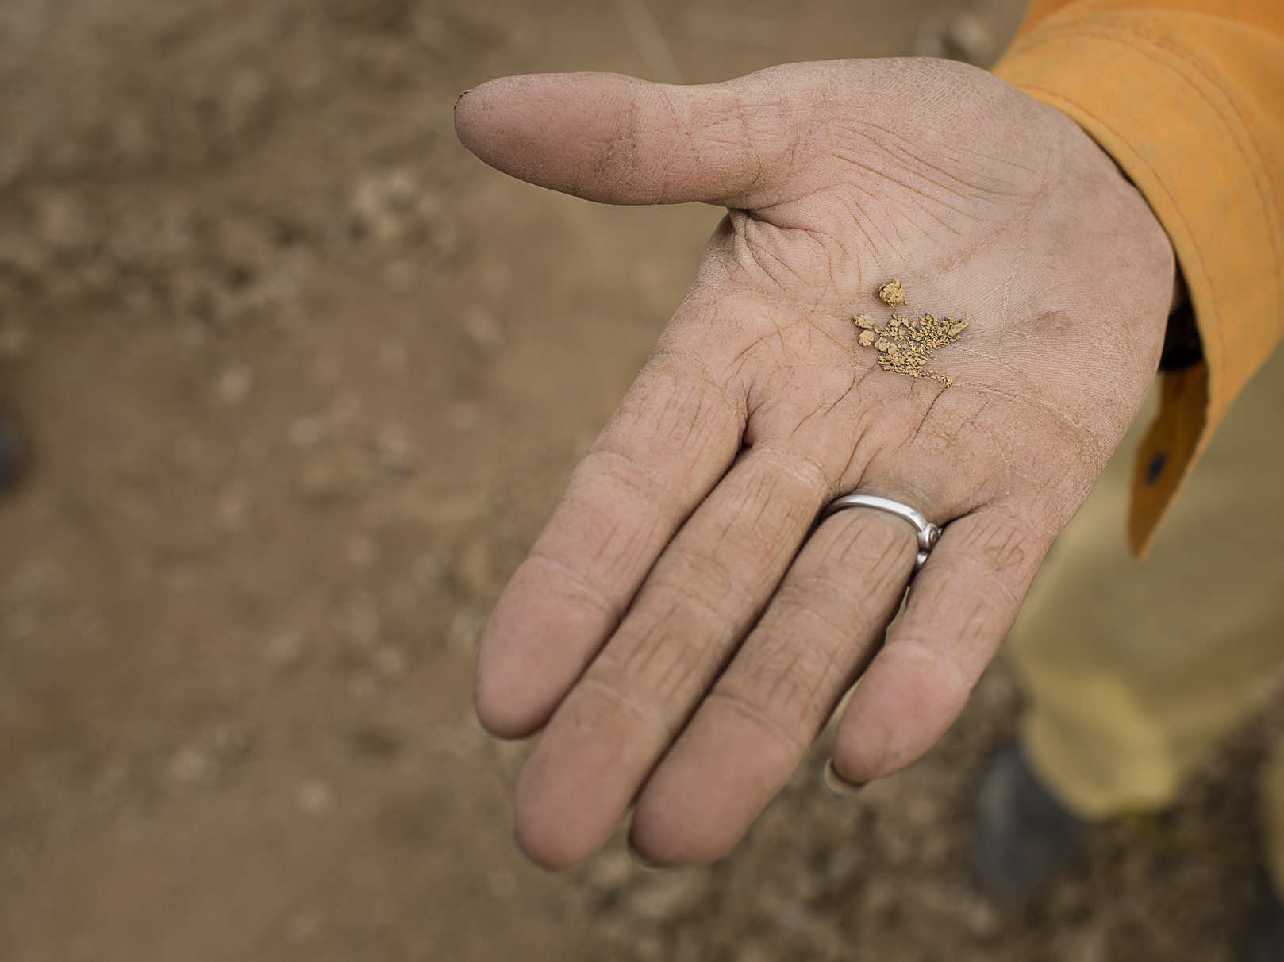
Artisanal and small-scale mining as a livelihood and business
Estimated 40.5 million ASM
Involved in the extraction of about 30 mineral commodities
70-80% of ASM are informal (please see slide 5)
Gold is the commodity most extracted by ASM (20% of the global gold supply)
It offers a source of immediate cash when other employment opportunities are missing or are difficult to access
It can give higher sources of revenue compared to other business activities
Photo Credit: Magnus Arrevad

Slide 5
Why artisanal and small-scale mining is important
Artisanal and small-scale mining is an important factor in local social and economic development:
Artisanal and small-scale mining is present in 80 countries and it is a source of income and revenue in rural areas, esp. for people with few other options.
Economic forward and backward linkages – economic diversification.
90% of the mining in the world is carried out by artisanal and small-scale mining (large employment source) – but only 10% of all the minerals come from ASM.
80% of the global sapphires and 20% of diamonds come from ASM
~20% of the global gold production in the world comes from ASM
26% of global tantalum production and 25% of tin production and 6% of tungsten come from ASM
3% of lead, 1% of zinc and 0.5% of copper come from ASM
Demand for electronics and electric vehicle batteries is leading to an increase in artisanal and small-scale mining activities in cobalt mining

Slide 6
Some risks related to the ASM sector
Informality (often don’t or can’t fulfil all the legal requirements)
Health and safety and working conditions (pits collapsing, malaria, flooding, dust diseases, etc.)
Worst forms of child labour, forced or bonded labour, other human rights risks
Financing of conflict or criminal activities
Informal taxation and corruption by those who are supposed to regulate the ASM sector
Local disputes or conflict over land use
Environmental impacts – depending on mineral extracted. Deforestation, soil and water contamination, use of chemicals (mercury, cyanide, etc.)
These are risks and they are NOT automatically prevalent in each ASM operation. They can occur, but are not intrinsic to all ASM.
These impacts/risks are NOT specific to ASM only. Tax evasion and corruption are also linked to LSM. ASM pay high “level of taxes” informally – these include bribes to officials, security and check points etc.

Slide 7
Why engage with ASM?
If due diligence is properly carried out, engaging with ASM can have positive impacts, such as:
Secure diverse and new sources of supply and respond to increasing consumer interest in materials and products that benefit producer communities.
Foster sustainable economic development in mining communities (contributing to the SDGs).
Foster sustainable economic development in mining communities, increase public revenues (contributing to the SDGs).
Reduce the share of minerals that finances conflict, human rights abuses and illicit activities of armed groups, criminal networks and terrorist organisations.
(Source: FAQ - Responsible Supply Chains in Artisanal and Small-Scale Gold Mining)

Slide 8
Learn more about ASM
Global Trends in Artisanal and Small-Scale Mining (ASM): A review of key numbers and issues
FAQ - Responsible Supply Chains in Artisanal and Small-Scale Gold Mining
Working together: How large-scale mining can engage with artisanal and small-scale miners
Backgrounder: Artisanal and Small–Scale Mining (ASM) in Developing Countries

Slide 9
Some existing initiatives to engage with
Fairmined (gold)
Fairtrade (gold and silver)
Just Gold (gold)
Commercially viable, conflict-free supply chain of Artisanal and Small-scale Mining (ASM) gold (gold)
Impact Facility
Better Gold Initiative (gold)
European Partnership for Responsible Minerals
Local NGOs’ initiatives

Slide 10
Thank you For further information visit the Due Diligence Ready! portal

